Slide 1


Spring Cloud Dataflow
for PCF
v.1.2.x
Wayne Lund
Content from Sabby Anandan &
Glenn Renfro
Last updated 05/19/2017

Slide 2
Agenda
What is Spring Cloud Dataflow?
Why Spring Cloud Dataflow?
Architecture Benefits
Dataflow Architecture
Dataflow Stream Basics
Dataflow Task Basics
Spring Cloud Streams for PCF
Spring Cloud Tasks for PCF
Plans & Deployment Types
Competitive Analysis
Roadmap
Licensing & Support
Resources

Slide 3







Spring Cloud Data Flow is
an orchestration service for composable
microservice applications on modern runtimes
Stream Processing
Batch Processing
Powered by: Spring Cloud Stream
Powered by: Spring Cloud Task
task create foobar --definition
“foo &&
< bar && baz || jaz >
&& bye”
foo
stream create foo --definition "http | transform | cassandra"
bar
jaz
transform
baz
bye
http
cassandra
Notes:
You can build production grade SCSt and SCT applications as standalone stack; however, once you have a several of them and you’d need an easy to orchestrate and operationalize them in in the wild.
That’s where Spring Cloud Data Flow comes in.
We call it: “a orchestration service for composable microservice applications on modern runtimes”
Let’s review SCSt and SCT in the context of SCDF.

Slide 4


Why Spring Cloud Dataflow?
Rise of Data Integration and Decision Making in Apps
4
Notes:
Intro: Today’s enterprise needs, distributed polyglot microservices architectures and the explosion of connected mobile devices requires the right messaging solution for those applications to be able to interoperate at scale
It demands an asynchronous messaging & queuing protocol that can support the distributed nature of those modern systems and stateless components across different platforms.
AMQP was created to support cross-platform messaging and interoperability between different systems by using a common format. It was designed to replace language and platform specific messaging formats such as JMS.
AMQP specification essentially creates a model that is completely client (API) or server (message broker) agnostic. As long as you are using AMQP you can connect and send messages to any AMQP message broker using any AMQP client.
Trans: Altogether RabbitMQ provides the necessary decoupling between components and allows for the management and distribution of workloads in a controllable way. That makes Pivotal RabbitMQ a key component of many web and enterprise distributed applications
------
Additional Notes:
Synchronous Architecture is Brittle: If any component is unavailable within a synchronous flow, all in-flight messages will be affected, regardless of what component they are currently in -- and since state is maintained across the components, the system can be complex to reset Asynchronous Architecture Rules the Web: In a standard async flow: All state is kept in the simple messages being passed. Each stateless component interacts only with the broker cloud. If a component is lost, only the in-flight messages within that component must be re-delivered. Components can be quickly provisioned on-demand
As systems grow in complexity, the interconnections between components also grow in complexity.
Messaging enables software applications to connect and scale.
Modern approaches to messaging are asynchronous to embrace the needs of the interoperability between apps, decoupling applications by separating sending and receiving data. Pivotal offers a JMS connector to RabbitMQ to ease the transition from your application messaging from JMS to AMQP/RabbitMQ

Slide 5



Why Spring Cloud Dataflow?
Data Integration Challenges
Flow of data largely
one way - from
transaction systems
to data warehouse
Traditional tools too
slow and rigid to
support changing
data flow patterns
supports legacy apps,
not modern, cloud-native
applications
Notes:
However, in order for such perishable insights to work in our favor and in a timely manner (because, context is important - what’s the point if the Uber App wrong data/map/drive-info?), we would have to get around the current set of challenges.
Let’s review some of the data integration challenges at a high-level.
Legacy ETL/ELT pipelines give ways to linear data processing;
Traditional ETL tooling are slow and often don’t allow new and dynamic data patterns;
Legacy data integration workloads are not easy to modernize and/or port to cloud-native style architectures

Slide 6




Why Spring Cloud Dataflow
Organizational Silos
App Dev
Data Engineering
Data Science
A system’s design is a copy of the organization’s communication structure
— M. Conway
Notes:
As for the organization challenges,
In an enterprise, we see silos. The data organization is disconnected from modern/cloud-native teams at the enterprise.
The tooling, best practices, and the software development processes are significantly different. It is different because of the serviceability and roadmap are different.
Often times, the tooling and practices followed by the data organization doesn’t give room to rapid iterations to deliver quicker value to the business.
From Adrian C.: It’s common to talk about “people, process and technology” when we look at changes in IT.
From Adrian C.: As an analogy, think how long it would take to make a model house starting with a ball of clay, compared to a pile of Lego bricks
https://medium.com/@adrianco/evolution-of-business-logic-from-monoliths-through-microservices-to-functions-ff464b95a44d#.xuureb21w

Slide 7

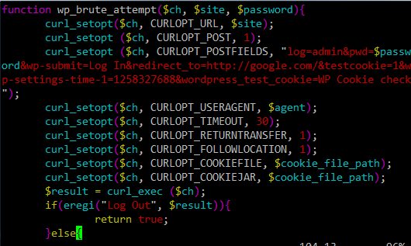
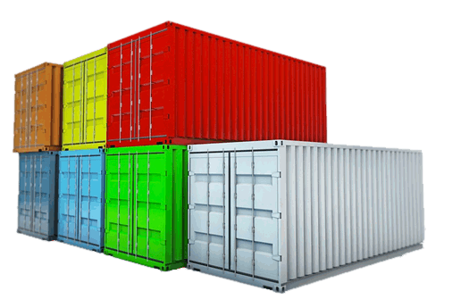
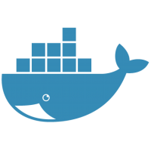



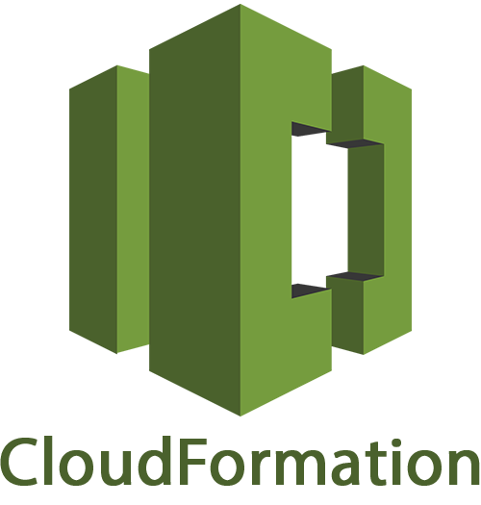
Why Spring Cloud Dataflow
Data Pipelines in Reality
batch processing
predictive analytics
etl
stream processing
data integration
Notes:
As a last broad type of challenge,
When an enterprise decides to build their own set of tooling and stack, it is not pretty.
Standards, expectations and proven ideas are once again being reinvented - why?
The teams tend to pickup tools as a tactical measure and it ends up being used in the production and because of that, they end up maintaining it like forever.
Given the varying requirements within the enterprise, it gets forked a few times, too. More fragmentation overall!

Slide 8

Architecture Benefits
Notes:
OK, so that’s some of the general set of challenges that we reviewed so far. Now that you’re aware of the problem space, let’s dive into solving them. Let’s go!
We are going to assume you’ve enough background about microservices.

Slide 9




Architecture Benefits
Microservices Turn Out to be
Great for Data Processing
Developing cloud-native applications provide:
continuous delivery
higher reuse
scalability and resilience

Slide 10


Architecture Benefits
AutoConfigure
Security
Dev-Tools
Spring Boot
Actuator
CLI
Starters
Logging
Health Checks
~10+M Downloads / Month
Notes:
Create standalone production grade spring applications that just “runs”!
Auto configure Spring where possible.
Don’t worry about boilerplate configurations; let Spring handle it for you; focus on the business logic instead.

Slide 11

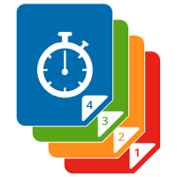

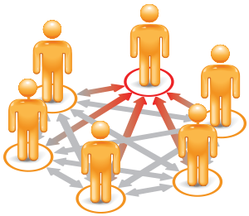


Architecture Benefits
Emerging Challenges
Service Discovery
Versioning
Fault Tolerance
Coordination
Load Balancing
Routing
Notes:
Microservices is no free-lunch; there are challenges, in fact, the distributed systems challenges are pretty significant.

Slide 12





Architecture Benefits
Hystrix
Eureka
Ribbon
Zuul
Feign
Service Discovery
Config Server
Control Bus
Spring Cloud
Config Server
Zookeeper
Distributed Tracing
Notes:
Here comes Spring Cloud! Takes the distributed systems challenges head-on!

Slide 13
Architecture Benefits
Spring Cloud
Service Discovery
Eureka, Consul
Versioning
Eureka, Config Server
Fault Tolerance
Hysterix
Coordination
ZooKeeper
Load Balancing
Ribbon
Routing
Zuul
Notes:
Microservices is no free-lunch; there are challenges, in fact, the distributed systems challenges are pretty significant.

Slide 14

SCDF Architecture Benefits
Data Pipelines in Reality
batch processing
predictive analytics
etl
stream processing
data integration
Notes:
Let’s revisit the challenges that we reviewed in the beginning.
You don’t have to fire-fight the operational requirements constantly; why do you need to build your homegrown data pipeline solution when you have several options?
There’s no tool that fits all the requirements.
Instead of choosing a technology or building your own stack, please embrace the ones that matter for your business.

Slide 15





SCDF Architecture Benefits
Data Pipelines in Reality
Notes:
Do you want to be in fire-fight mode constantly or you’d prefer being more productive and focus on business values that matter to your customers and of course your organization?

Slide 16
SCDF Architecture Benefits
Repeatable Process
Spring Boot Apps
Consistent Dev, Testing, and CI Tooling
Extensible Abstractions
Declarative DSL and Pipelines
Drag & Drop GUI and Pipelines
REST-APIs and Rapid Dashboarding
Unified Stream and Batch Processing
Notes:
“Simple things should be simple; complex things should be possible”

Slide 17
SCDF Architecture Benefits
Consistency
App Dev |
Data Engineering
| Data Science
Notes:
Spring, Spring Boot and SCDF offer consistent set of tools, patterns, and best practices. Silos could meltdown to form a more coherent experience across the all the teams.

Slide 18

Dataflow Architecture
Spring Cloud Data Flow
DSL/Shell
REST-API/Dashboard
Flo Visual Designer
Spring Cloud Stream
Spring Cloud Task
Spring Integration
Spring Boot
Spring Batch
Spring Cloud Data Flow is built from the group up with microservice architecture in mind. The product is
made up of several microservice projects and sub-modules. This picture highlights the top-level projects .
Notes:
Spring Cloud Data Flow is built from the group up with microservice architecture in mind. The product is made up of several microservice projects and sub-modules. This picture highlights the top-level projects alone and we will cover all of them today.
You’ll see this visual a few times today. This is a roadmap for the Spring Cloud Dataflow Overview. Based on the topic we are to cover, we will see color-coded boxes in this visual - you will get an idea what we are cover.

Slide 19




Dataflow nArchitecture
Stream
Batch
longer running
services
short lived
processes

Slide 20

Dataflow Architecture
Task = Short Lived
Spring Batch
enables the development
of robust batch applications vital for the daily operations of enterprise systems
Spring Cloud Task
enables you to develop and run short-lived executable data applications locally or in the cloud
Notes:
We have seem streaming solutions, but there’s batch/task based workloads that is equally important in enterprise setting.
In Spring’s portfolio, we have have had Spring Batch (SB) for about 9+ yrs in production. This project allows you to build batch applications rapidly.
To further simplify developing batch applications with SB at its foundation, Spring Cloud Task as project was spun-out. Apart from SB, this project also builds upon Spring Boot and Spring Cloud patterns and best practices, too.
In 1-line, SCT provides short-lived microservices framework, so you can quickly build standalone production grade task applications. They are short-lived because the application runs and it is live only as far as the business logic embedded in it is operational. Again, Spring Boot applications all the way.

Slide 21

Dataflow Architecture
Spring Boot
Spring Cloud
Spring Cloud Stream
Spring Cloud Task
Spring Cloud Data Flow
“an orchestration service for composable microservice
applications on modern runtimes”
Notes:
You can build production grade SCSt and SCT applications as standalone stack; however, once you have a several of them and you’d need an easy to orchestrate and operationalize them in in the wild.
That’s where Spring Cloud Data Flow comes in.
We call it: “a orchestration service for composable microservice applications on modern runtimes”
Let’s review SCSt and SCT in the context of SCDF.

Slide 22

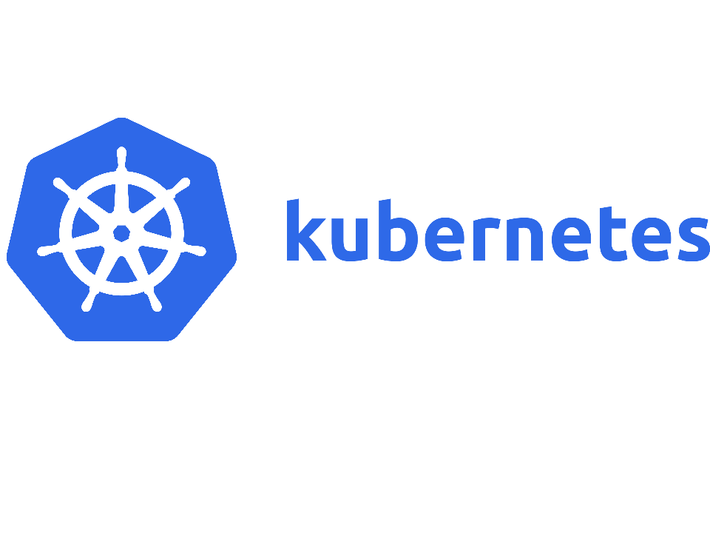



Dataflow Architecture
}
Runtime Abstraction
}
Core
Community
Notes:
SCDF builds an abstraction that’s easy to extend. We are not too opinionated. You have options to operationalize SCDF in variety of runtimes.

Slide 23

Dataflow Stream Basics
Spring Cloud Data Flow
DSL/Shell
REST-API/Dashboard
Flo Visual Designer
Spring Cloud Stream
Spring Cloud Task
Spring Integration
Spring Boot
Spring Batch
Notes:
Here’s the workshop roadmap again. In this session, we are going to review Spring Cloud Stream and the projects that it builds on.

Slide 24
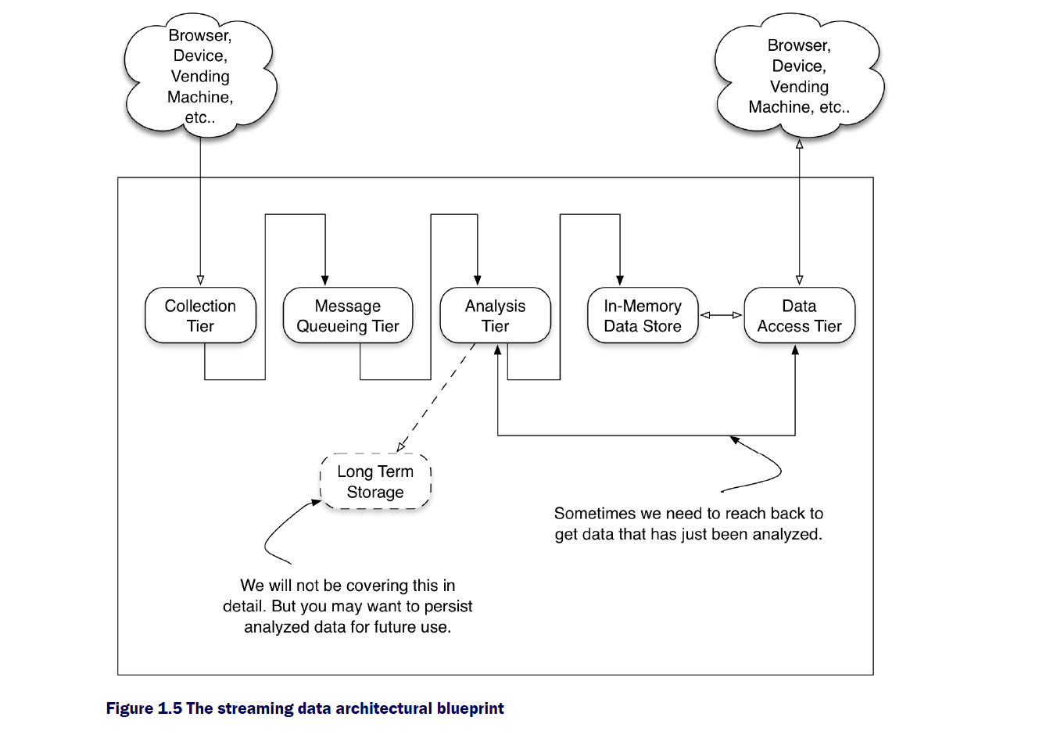
Dataflow Stream Basics
Streaming Data Blueprint
Notes:
Taken from “Streaming Data”

Slide 25
Stream data
Streaming Data Blueprint SCDF Overlay
_{rabbitmq}
_{Kafka}
_{gemfire}
_{mongo}
_{cassandra}
_{Etc.}
_{redis}
_{src}
_{processor}
_{sinks}
_{hdfs}
_{greenplum}

Slide 26


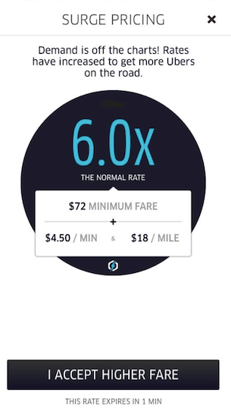



Dataflow Stream Basics
Data Insights
Recommendation
Insights
Performance
Insights
Strategic
Insights
ms —> s
s —> hrs
hrs —> wks
Notes:
In an enterprise setting, there is requirement to process data at various stages. Some require sub-second processing and there are cases for weeks to sometimes years worth of data that needs collected for larger strategic reasons.
To simplify this, let’s review this chart.
ms -> s processing requires insights right when the event occurred; users need immediate actionable insights to make decision. For example, think of amazon carts - you get recommendations such as “users who have bought this also bought 1, 2, 3 …”
At times we would need some data collection to make decisions such as optimizing your recommendation engine or for that matter think of a email marketing campaign - whether it works or not, you wouldn’t know until you’ve had some provable data points to back it. The optimizations on such campaigns can be incremental from then on.
The historical data along with real-time events tell a different story. A story that could relate to strategic decisions at the enterprise. Examples include “acquisition of a company to fill the growing demands”, “expanding line of products to be more lucrative” etc.

Slide 27
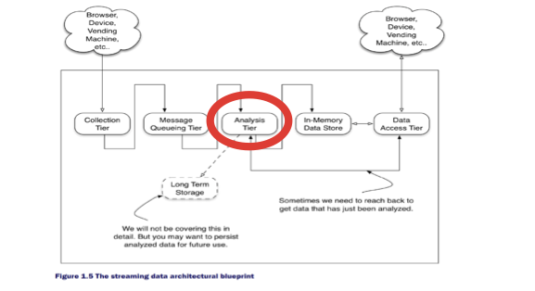
Dataflow Stream Basics
Requirements for Real-time Insights
Real-time Data Processing | High Throughput | Grouping | Async Interaction
Heterogeneous Data Processing | Low Latency | Ordering | Command Query Responsibility Seggregation
 | Resiliency | Partitioning | Event Sourcing
 |  | Windowing
Notes:
Now that we have a general idea about enterprise data and the various stages they add value to the business, let’s review what streaming data requirements are. The business requirements that need sub-second to seconds decisions.

Slide 28
Dataflow Stream Basics
Streaming = Long Running
Spring Integration
enables lightweight messaging within Spring-based applications and supports integration with external systems
Spring Cloud Stream
enables you to create powerful event-driven streaming data applications with a minimal amount of coding
Notes:
In Spring’s portfolio, we have have had Spring Integration (SI) for about 9+ yrs in production. This project allows you to connect to external system such as file-systems, messaging middlewares, hadoop, sql-no-sql stories, etc.
To further simplify developing integration applications with SI at its foundation, Spring Cloud Stream project was spun-out. Apart from SI, this project also builds upon Spring Boot and Spring Cloud patterns and best practices, too.
In 1-line, SCSt provides event-driven microservices framework, so you can quickly build standalone production grade streaming applications. You’re developing a well-known and familiar Spring Boot applications at the end of the day.

Slide 29

Dataflow Stream Basics
Programming Model
Source
Processor
Sink
@EnableBinding(Source.class)
@SpringBootApplication
public class SourceApplication {
..
..
}
@EnableBinding(Processor.class)
@SpringBootApplication
public class ProcessorApplication {
..
..
}
@EnableBinding(Sink.class)
@SpringBootApplication
public class SinkApplication {
..
..
}
Discover
Output
Channel
Discover Input and Output
Channels
Discover
Input
Channel
Auto
Configure
Discover
Binder
Bind
Producer
Auto
Configure
Discover
Binder
Bind
Producer and Consumer
Auto
Configure
Discover
Binder
Bind
Consumer
Discover
Type
Converter
Discover
Type
Converter
Discover
Type
Converter
@Poller
@Transformer
@ServiceActivator
@ServiceActivator
@StreamListener/ @SendTo
@StreamListener/ @SendTo
Notes:
A quick glance at 3 OOTB types of applications in SCSt. This is extendable; you can write your own interface with multiple channels in it, too. In other words, these 3 OOTB types aren’t the only ones possible via SCSt.
Since SCSt builds upon SI at its foundation, all that applies in SI can be leveraged here as well.
High-level annotations to interact with the payload offered by SI:
http://docs.spring.io/spring-integration/api/org/springframework/integration/annotation/package-summary.html

Slide 30
Dataflow Stream Basics
Programming Model Contd.
package org.springframework.cloud.stream.messaging; public interface Processor {
String INPUT = "input";
String OUTPUT = “output";
@Input(Sink.INPUT) SubscribableChannel input();
@Output(Source.OUTPUT) MessageChannel output();
}
@EnableBinding(Processor.class)
@SpringBootApplication public class UpperCase { @ServiceActivator(inputChannel = Processor.INPUT, outputChannel = Processor.OUTPUT) public Object uppercase(Object incomingPayload) { return incomingPayload.toString().toUpperCase(); }
}
Notes:
A deep-dive into the programming model. You’ll be doing this in the lab momentarily.
The Processor interface.
SCSt is backed by generic abstraction called “channels”. It is the channel through which the bindings to a topic/queue that occurs. The data flows through these channels backed by the messaging middleware.

Slide 31


Dataflow Stream Basics
Spring Cloud Stream Application
Input Messaging Channel
Messaging
Middleware
B
I
N
D
E
R
payload = foo
E
V
E
N
T
S
payload = FOO
upperCase()
Output Messaging Channel
Notes:
Read this visual from left -> right.
A lot of real-time events are happening; think of sensor data or the website clicks etc.
All of those events are reaching the messaging middleware and a SCSt application is subscribed to the topic where the messages land.
Being an event-driven application, the messages are continuously consumed by the applications through the automation of configuration and connection provided by SCSt framework.
Messages received by the applications are consumed by the “INPUT” channel and the business logic can be applied at this layer. The transformed payload is now pushed back to the messaging middleware via the “OUTPUT” channel for downstream processing.
In this example, we are seeing a simplistic use-case of payload transformation. A simple “upperCase()” example.

Slide 32
Demo: upperCase()

Slide 33
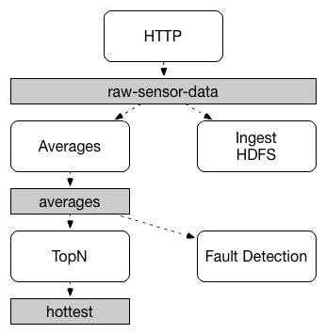
Dataflow Stream Basics
Concepts: Persistent Pub/Sub Semantics
Primitives for streaming and event-driven
data processing
Notes:
With SCSt, you can build both streaming and event-driven applications.
A streaming pipeline to ingest, process and write data fragments as quickly as possible (eg., etl, streaming analytics)
An event-driven pipeline that kicks-off downstream processing (eg., event sourcing; async interaction)

Slide 34
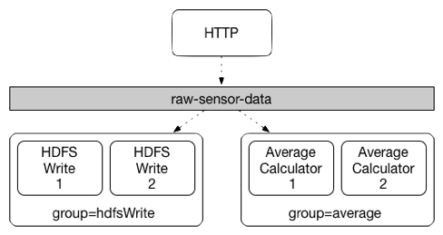
Dataflow Stream Basics
Concepts: Consumer Groups
Groups of competing
consumers within
the pub-sub
destination
Notes:
Inspired from Apache Kafka’s “consumer group” functionality, SCSt provides a similar capability at the binding mechanism.
When doing this, different instances of an application are placed in a competing consumer relationship, where only one of the instances is expected to handle a given message.

Slide 35
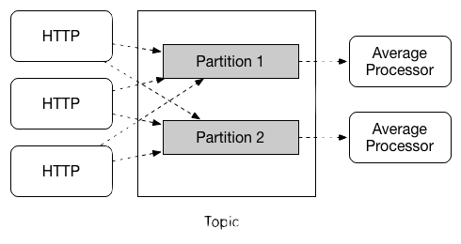
Dataflow Stream Basics
Concepts: Partitioning
Primitives for stateful stream processing
Notes:
When publishing a keyed message, the SCSt’s binding mechanism deterministically maps the message to a partition based on the hash of the key. This provides a guarantee that messages with the same key are always routed to the same partition.
Grouping/ordering is important when doing stateful stream processing.
Imagine an IoT use-case where there are millions of sensor devices are in the grid. The streaming pipeline should be in a situation to process the data that belong to each device/sensor correctly. You don’t want to process wrong sensor data and end up with wrong calculations, which of course would trigger wrong predictions - wrong insights - wrong business decisions.

Slide 36
Demo: Partitions & Consumer Groups

Slide 37


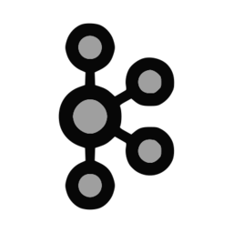




Dataflow Stream Basics
Binder Abstraction
Development
Experimental
Production
TEST BINDER
(only for dev)
Notes:
Lastly SCSt is built with binding mechanism at its core and there’s an abstraction put in place at this level.
Today, we recommend Apache Kafka or RabbitMQ as the messaging middleware for production setting. However, there’s few other options in various stages of release cadence.
Test binder is something you’d use in DEV. This is super easy for unit/integration testing
Experimental binders are in the process of graduating to a production quality binder
Of course, kafka and rabbit are ready to use in production

Slide 38
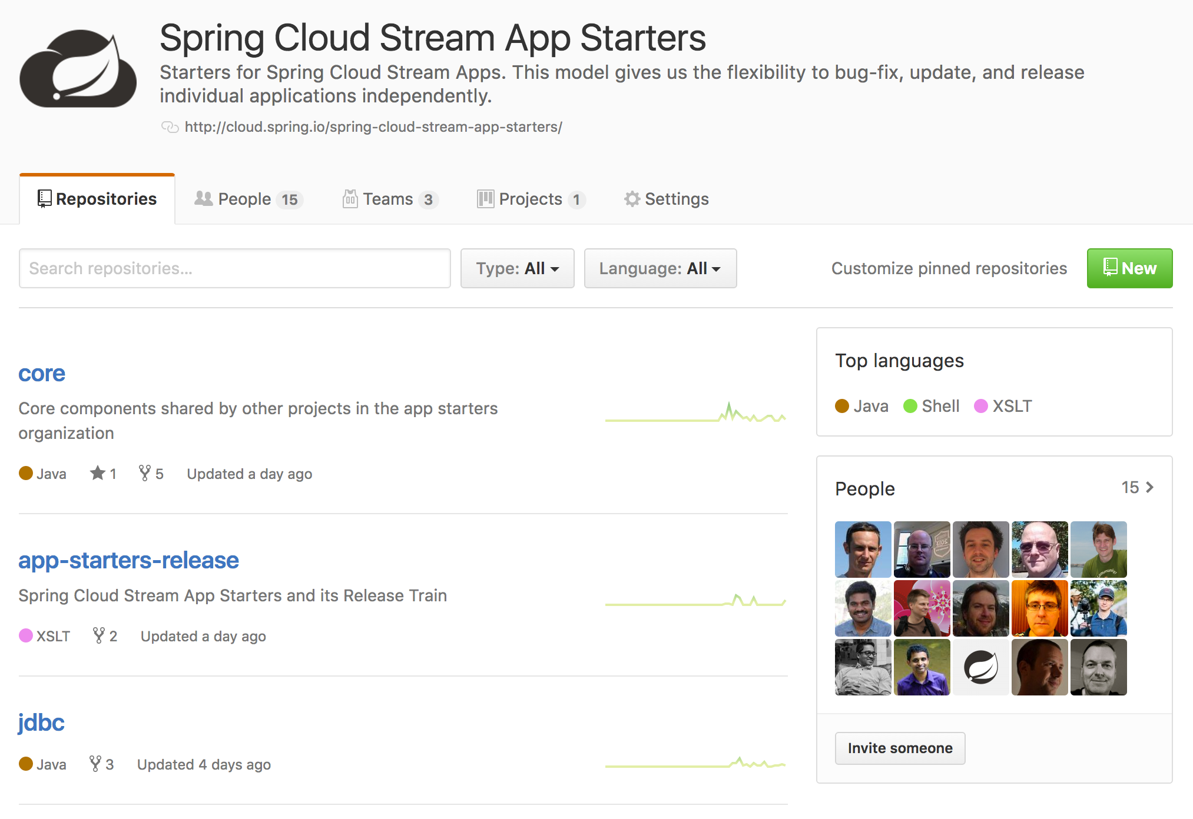
52 Application Starters & Counting!
https://github.com/spring-cloud-stream-app-starters

Slide 39
Dataflow Task Basics
Spring Cloud Data Flow
DSL/Shell
REST-API/Dashboard
Flo Visual Designer
Spring Cloud Stream
Spring Cloud Task
Spring Integration
Spring Boot
Spring Batch

Slide 40
Dataflow Task Basics
What is a Task?
In SCSt what we see are LRP or long running processes
If they fail they get restarted
And they run till they are shut down
Tasks are ephemeral
Once completed they stop.
The framework does not restart them.
Good when you need to perform a certain amount of work then terminate
Reduced cost - Only charged for the run time they are up
Reduced need for resources.
Notes:
In SCSt what we see are LRP or long running processes
If they fail what they get restarted
And they run till they are shut down
Tasks are ephemeral
Once complete they stop.
The framework does not restart them.
Good when you need perform a certain amount of work then terminate
Reduced cost - Only charged for the run time they are up
Reduced need for resources.
https://flic.kr/p/8HDJ5B

Slide 41
Dataflow Task Basics
What is
Spring Cloud Task?
Spring Cloud Task is a Ephemeral microservice framework
Built on Spring stack:
Spring Boot: full-stack standalone apps, configuration
Provides features required for a task in a cloud environment
Common abstractions
Records the task state information in a datastore
Emits Task Event at start and stop of task
Job events as well
Provides listeners for before, failed, and after events for a task
Notes:
Spring Cloud Task is a Ephemeral microservice framework
Built on Spring stack:
Spring Boot: full-stack standalone apps, configuration
Provides features required for a task in a cloud environment
Common abstractions
Records the task state information in a datastore
Emits Task Event at start and stop of task
Job events as well
Provides listeners for before, failed, and after events for a task
https://flic.kr/p/8HDJ5B

Slide 42

Dataflow Task Basics
Persists
Task Execution
Persists the TaskExecution event to RDBMS data store or in memory at
Task Start
Task End
To Enable:
spring-cloud-starter-task
Add boot-starter-jdbc dependency
Add database dependency
Creates TaskExecution on start
Updates TaskExecution entry upon completion
End Time
Exit Code
Exit Message
Error Message
Notes:
Persist Task Execution
Persists the TaskExecution event to RDBMS data store or in memory at
Task Start
Task End
To Enable:
spring-cloud-starter-task
Add boot-starter-jdbc dependency
Add database dependency
Creates TaskExecution on start
Updates TaskExecution entry upon completion
End Time
Exit Code
Exit Message
Error Message
https://flic.kr/p/7DUk5

Slide 43
Dataflow Task Basics
@SpringBootApplication
@EnableTask
public class TaskApplication {
public static void main(String[] args) {
SpringApplication.run(TaskApplication.class, args);
}
public class TimestampTask implements
CommandLineRunner {
public void run(String... strings) throws Exception {
...
}
}
}
Notes:
So what we see is that it is a core Spring boot application that is using a CommandLineRunner.
The primary differentiator is that we have the annotation @EnableTask

Slide 44
Dataflow Task Basics
<dependency>
<groupId>org.springframework.cloud</groupId>
<artifactId>spring-cloud-starter-task</artifactId>
</dependency>
<dependency>
<groupId>org.springframework.boot</groupId>
<artifactId>spring-boot-starter-jdbc</artifactId>
</dependency>
<dependency>
<groupId>org.mariadb.jdbc</groupId>
<artifactId>mariadb-java-client</artifactId>
</dependency>
Notes:
The dependencies above provide the following:
spring-cloud-starter-task Auto configures the boot application to be a task
spring-boot-starter-jdbc Auto configures a datasource for the application and by default task will use it as well.
mariadb-java-client Establishes what database driver to use for your application. In this example we are using the opensource driver for mysql.

Slide 45

Dataflow Task Basics
Task Events
Emit TaskEvent via Spring Cloud Stream channel
Task Start
Task End
Automatically enabled when SCSt dependency is added for example
<dependency>
<groupId>org.springframework.cloud</groupId>
<artifactId>spring-cloud-starter-stream-rabbit
</artifactId>
</dependency>
Notes:
Task Events
Emit TaskEvent via Spring Cloud Stream channel
Task Start
Task End
Automatically enabled when SCSt dependency is added for example
https://flic.kr/p/oHpnei

Slide 46

Dataflow Task Basics
Emit BatchEvents via Spring Cloud Stream channel
job-execution-events
step-execution-events
chunk-events
item-read-events
item-process-events
item-write-events
skip-events
Notes:
Batch Events
Emit BatchEvents via Spring Cloud Stream channel
job-execution-events
step-execution-events
chunk-events
item-read-events
item-process-events
item-write-events
skip-events
https://flic.kr/p/82tvyd

Slide 47

Dataflow Task Basics
Remote
Partitioning
Spring Batch provides an SPI for partitioning a Step execution and executing it remotely.
Spring Cloud Task provides the infrastructure to allow a user to execute Batch Partitions on most cloud platforms.
This is done using Spring Cloud Deployer.
An example of this can be seen here: https://github.com/spring-cloud/spring-cloud-task/tree/master/spring-cloud-task-samples/partitioned-batch-job
Notes:
Remote Partitioning
Spring Batch provides an SPI for partitioning a Step execution and executing it remotely.
Spring Cloud Task provides the infrastructure to allow a user to execute Batch Partitions on most cloud platforms.
This is done using Spring Cloud Deployer.
An example of this can be seen here: https://github.com/spring-cloud/spring-cloud-task/tree/master/spring-cloud-task-samples/partitioned-batch-job
https://flic.kr/p/dHH8ui

Slide 48

Dataflow Task Basics
Cool, but how do you make it work?
@BeforeTask
public static void beforeTask(TaskExecution) {
...
}
@AfterTask
public static void afterTask(TaskExecution) {
...
}
@FailedTask
public static void failedTask(TaskExecution,
Throwable) {
...
}
Notes:
https://flic.kr/p/8stahR

Slide 49
Dataflow Task Basics
Or just use the Spring Initializer… ;-)
Notes:
Just remember in your tests add the following line below your @SpringBootTest
@TestPropertySource(properties = {"spring.cloud.task.closecontext_enable=false"})

Slide 50
Dataflow Task Basics
Demo Time!

Slide 51
Spring Cloud Streams for PCF
Spring Cloud Data Flow
DSL/Shell
REST-API/Dashboard
Flo Visual Designer
Spring Cloud Stream
Spring Cloud Task
Spring Integration
Spring Boot
Spring Batch
Notes:
We are going to revisit stream processing in the context of SCDF. The benefits of orchestration aspects of SCDF is what we are going to cover.

Slide 52
Spring Cloud Streams for PCF
Stream Processing in Spring Cloud Data Flow
dataflow:>stream create foo --definition "http --port=9001 | uppercase | log" --deploy
1
3
http
B
I
N
D
E
R
B
I
N
D
E
R
log
2
4
upperCase()
Notes:
This is the same example that we saw in Streams labs. Let’s revisit it in the context of SCDF.
First and foremost, the DSL. This is where the power is. Inspired by UNIX’s pipes and filter syntaxes, the SCDF DSL includes a powerful representation of both linear and complex streaming pipeline topologies.
The same uppercase() can be defined multiple ways. We are all about options.
you can register the same application that you had developed in the lab and reuse it here
you can use SpEL expressions to compute simple to a complex transformations
“Easy to build or customize; fast you can build topologies; quick you can promote to production”
Same as:
dataflow:> stream create --definition "http | transform --expression=payload.toUpperCase() | log" --name mystream --deploy

Slide 53
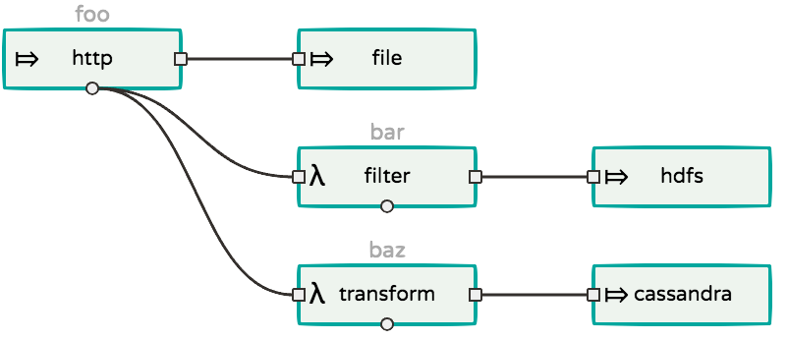
Spring Cloud Streams for PCF
Wiretaps in Streams
dataflow:>stream create foo --definition "http --port=9001 | file”
dataflow:>stream create bar --definition “:foo.http > filter | hdfs”
dataflow:>stream create baz --definition “:foo.http > transform | cassandra”
Notes:
There are some responsibilities for primary data pipeline. The pipeline that writes RAW data to a master dataset; something like hadoop or s3 for example.
While that’s happening, if you’d want to fork and get a copy of same data and do some ad-hoc analytics or some other downstream processing, yes, you can in SCDF.
We call it TAPing the stream. Again, the DSL provides easy to use syntaxes to TAP a copy of data.
stream foo - Data from http port=9001 written to S3.
stream bar - TAPs data from the producer on foo stream and the copy of data is then sent to “hdfs” after some cleansing through “filter” processor.
stream baz - TAPs data from the producer on foo stream and the copy of data is now sent to “cassandra" after some transformation through “transform” processor.
Below you’d see the flo representation of this complex topology. It is easy to read and understand.

Slide 54
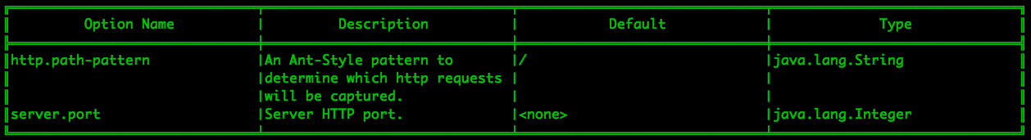
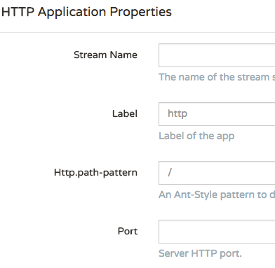
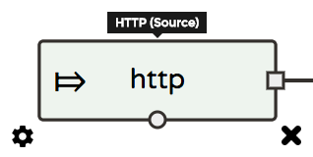
Spring Cloud Streams for PCF
Application Properties
dataflow:>app info source:http
Notes:
Fundamentally, everything in the pipeline is a Spring Boot application. All Boot goodies apply to these applications, too.
Specifically, the properties are a powerful feature in Boot; with that, we could override the application behavior at runtime.
There are multiple ways one can enable such properties and likewise, there are plenty of ways to override them in Boot. Refer to Boot’s ref. guide for more details: https://docs.spring.io/spring-boot/docs/current/reference/html/common-application-properties.html
Building upon this, SCDF and the ecosystem of projects provide similar support, too. From SCDF perspective, the DSL lends easy to use method of overriding application properties.
In this example, you are seeing all the overridable properties for “http-source” application. The same can be overridden when you create pipelines via Flo.

Slide 55
Spring Cloud Streams for PCF
Deployment Properties
Simple Stream
dataflow:>stream create foo --definition “http --port=9001 | log”
Scale-out Deployment
dataflow:>stream deploy foo --properties “app.log.count=2”
Partitioned Stream
dataflow:>stream deploy foo --properties “app.http.producer.partitionKeyExpression=payload”
Stream Binding Overrides
dataflow:>stream deploy foo --properties ”app.http.spring.cloud.stream.bindings.output.destination=bar,
app.log.spring.cloud.stream.bindings.input.destination=bar”
Notes:
We reviewed application properties.
When deploying the stream, properties that control the deployment of the apps into the target platform are known as deployment properties. SCDF provides easy method to override them as well.
Imagine a simple stream “http | log”
Now, if you’d want to deploy 2-instances of log-sink, you’d do that via “app.log.count=2”
If you’d want to supply a partitioning method for the producer (http-source), you’d do that via: “app.http.producer.partitionKeyExpression=payload”
If you’d want to override the default destinations (generated by SCDF = <server-name>.<stream-name>.<app-name>) for your producer and consumer applications to connect, you’d do that via ”app.http.spring.cloud.stream.bindings.output.destination=bar,app.log.spring.cloud.stream.bindings.input.destination=bar”
http://docs.spring.io/spring-cloud-stream/docs/Chelsea.M1/reference/htmlsingle/#_configuration_options

Slide 56
Spring Cloud Streams for PCF
Properties via Reference File
app.http.producer.partitionKeyExpression=payload app.http.spring.cloud.stream.bindings.output.destination=bar app.log.spring.cloud.stream.bindings.input.destination=bar app.log.count=2
Properties File
dataflow:>stream deploy foo --propertiesFile myprops.properties
YAML File
dataflow:>stream deploy foo --propertiesFile myprops.yml
app: http: producer: partitionKeyExpression: payload spring: cloud: stream: bindings: output: destination: bar .... .... ....
Notes:
Properties can be provided as plain “.properties” or as “.yml” artifacts.

Slide 57
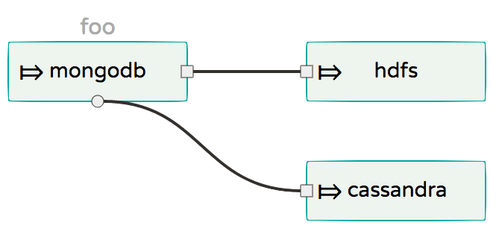


Spring Cloud Streams for PCF
Properties via Reference File
Config
Server
app.mongodb.producer.partitionKeyExpression=payload app.mongodb.spring.cloud.stream.bindings.output.destination=bar app.hdfs.spring.cloud.stream.bindings.input.destination=bar app.cassandra.spring.cloud.stream.bindings.input.destination=bar app.cassandra.count=2
Notes:
Alternatively, you can also use config-server backed by a centralized GIT to resolve properties more dynamically via “profiles” at the runtime.

Slide 58
Spring Cloud Streams for PCF
Explicit Broker Destinations
Destination as a Source
dataflow:>stream create foo --definition “:myFancySourceDestination > log”
Destination as a Sink
dataflow:>stream create foo --definition “http > :myFancySourceDestination”
Notes:
You can connect directly to a queue/topic and the DSL for doing that is what you’re seeing in this slide.
You don’t need an explicit application as source/sink is the point. This method is more flexible and it eliminates the requirement to code, test and build producers from scratch.

Slide 59


Spring Cloud Streams for PCF
Advanced Broker Interactions
http
transform
log
Stream Definition
dataflow:>stream create foo --definition “http | transform --expression=payload.toUpperCase() | log”
Stream Deployment
dataflow:>stream deployment foo --properties
"app.http.spring.cloud.stream.bindings.output.binder=rabbitBinder,
app.transform.spring.cloud.stream.bindings.input.binder=rabbitBinder,
app.transform.spring.cloud.stream.bindings.output.binder=kafkaBinder,
app.log.spring.cloud.stream.bindings.input.binder=kafkaBinder"
Notes:
GLOBAL configurations provided at the SERVER level:
spring.cloud.dataflow.applicationProperties.stream.spring.cloud.stream.binders.rabbitBinder.type=rabbit
spring.cloud.dataflow.applicationProperties.stream.spring.cloud.stream.binders.rabbitBinder.environment.spring.rabbitmq.host=awesome1.dev
spring.cloud.dataflow.applicationProperties.stream.spring.cloud.stream.binders.rabbitBinder.environment.spring.rabbitmq.port=90000
spring.cloud.dataflow.applicationProperties.stream.spring.cloud.stream.binders.kafkaBinder.type=kafka
spring.cloud.dataflow.applicationProperties.stream.spring.cloud.stream.binders.kafkaBinder.environment.spring.cloud.stream.kafka.binder.brokers=awesome2.dev:9092
spring.cloud.dataflow.applicationProperties.stream.spring.cloud.stream.binders.kafkaBinder.environment.spring.cloud.stream.kafka.binder.zkNodes=awesome2.dev:2181
It is easy to build complex pipelines that interact with multiple binder implementations.
Imagine a requirement that is strictly only requires RabbitMQ for some processing - perhaps something to do with Rabbit’s powerful security features.
At the same time, a team would like to use Kafka for some high throughput / low-latency downstream processing.
Both of these requirements are legit and in SCDF, we provide easy options to plug different binding implementation between producers and consumers. This visual represents that.

Slide 60
Spring Cloud Streams for PCF
Reactive Stream Processing
@SpringBootApplication @EnableBinding(Processor.class) public class SensorAverageApplication {
@StreamListener @Output(Processor.OUTPUT) public Flux<AverageData> calculateAverage(@Input(Processor.INPUT) Flux<ReceivedSensorData> data) { return data.window(Duration.ofSeconds(20), Duration.ofSeconds(10)) .flatMap(window -> window.groupBy(sensorData -> sensorData.getId()) .flatMap(group -> calculateAverage(group))); } ... ...
}
@EnableRxJavaProcessor public class RxJavaTransformer {
@Bean public RxJavaProcessor<String,String> processor() { return inputStream -> inputStream.map(data -> { return data; }).buffer(5).map(data -> String.valueOf(avg(data))); } ... ...
}
i0
..
10
11
12
13
14
15
16
17
18
19
..
12
i1
..
10
11
12
13
14
15
16
17
18
19
..
17
Notes:
Spring Cloud Stream also supports the use of reactive APIs where incoming and outgoing data is handled as continuous data flows.
Instead of specifying how each individual message should be handled, you can use operators that describe functional transformations from inbound to outbound data flows.
Project Reactor and RxJava APIs are more natively supported at the programming model.
With this, you can build complex computation business logic in your applications. Examples include “moving-average”, “time-windowing”, “aggregations” — all this can be easily done in the application itself. They can be registered in SCDF to build complex streaming topologies using the DSL/Flo.
A moving-average example is shown in this slide. For every 5-entries coming from the upstream application, the average is calculated and the outcome is sent to downstream app for processing/persistence.
http://docs.spring.io/spring-cloud-stream/docs/Chelsea.M1/reference/htmlsingle/#_reactive_programming_support

Slide 61
Spring Cloud Task for PCF
Spring Cloud Data Flow
DSL/Shell
RES-API/Dashboard
Flo Visual Designer
Spring Cloud Stream
Spring Cloud Task
Spring Integration
Spring Boot
Spring Batch

Slide 62
Spring Cloud Task for PCF
Batch Processing
Triggered or Scheduled | Mass Volumes of Data Processing | Remote Partitioning | Hybrid: Streaming and Batch
Short-lived | Transactional | Ordering | Offline Machine Learning
 | Guarantees
Notes:
Before we get to far into what SCDF can do with tasks, let’s review some Batch basics
Some event kicks them off either automated (scheduled) or an event (user or some other Task or Long Running Process)
Many times handles mass volumes of data
Most of this work is transactional with some form of guarantee that it completes
Batch processing may utilize Remote partitioning or ordering
Example uses of batch apps
Batch Apps can be launched as a part of a stream
Or as offline machine learning projects.

Slide 63
Spring Cloud Task for PCF
Task = Short Lived
Spring Batch
enables the development
of robust batch applications vital for the daily operations of enterprise systems
@EnableTask
Spring Cloud Task
enables you to develop and run short-lived executable data applications locally or in the cloud

Slide 64
Spring Cloud Task for PCF
Batch Processing in Spring Cloud Data Flow
Register you application
dataflow:>app register --name timestamp --type task --uri file:///tmp/timestamp-task-1.1.0.RELEASE.jar
Notes:
First thing you want to do is register your application
This notifies Spring Cloud DataFlow that this is an application is a task and can be used in task definitions.

Slide 65
Spring Cloud Task for PCF
Batch Processing in Spring Cloud Data Flow
Simple Task
dataflow:>task create foo --definition “timestamp”
Launch Task
dataflow:>task launch foo
Review Logs
Notes:
Once you have registered the application we want to create a task definition.
A task definition is the establishes how a task execution should be executed.
Now you can launch the task and check the results.
You can launch a task multiple times.
They can run simultaneously
You can also put in properties for your task at
Task Definition time or

Slide 66
Spring Cloud Task for PCF
Batch Processing in Spring Cloud Data Flow
Set Properties at definition time
dataflow:>task create foo --definition “timestamp --format=YYYY”
Set Properties via arguments at launch time
dataflow:>task launch foo --arguments "--timestamp.format=YYYY"
Set Properties via properties at launch time
dataflow:>task launch foo --properties “app.timestamp.format=YYYY"
Notes:
You can set properties via:
Task Definition
Arguments at launch time
Properties at launch time

Slide 67
Spring Cloud Task for PCF
Getting the Info
Receive a list of available task definitions
dataflow:>task list
Receive a list of previous task executions
dataflow:>task execution list
Get details on a specific task execution
dataflow:>task execution status --id 1

Slide 68
Spring Cloud Task for PCF
Task/Batch Lifecycle Events
Task events | task-events
Job Execution events | job-execution-events
Step Execution events | step-execution-events
Item Read events | item-read-events
Item Process events | item-process-events
Item Write events | item-write-events
Skip events | skip-events
Notes:
When a user adds spring-cloud-stream-app-starters:
Tasks will emit the following events to a stream:
task-events (Start Task, End Task)
If the task is a Spring Batch the following events will be emitted:
job-execution-events
step-execution-events
item-read-events
item-process-events
item-write-events
skip-events

Slide 69
Spring Cloud Task for PCF
Lifecycle Events Subscription
Simple Task
dataflow:>task create foo --definition “batch-event”
Launch Task
dataflow:>task launch foo
TAP Task Events Channel
dataflow:>stream create bar --definition “:task-events > log” --deploy
Notes:
In the example above we see that we have registered the batch-event example from Spring Cloud Task
https://github.com/spring-cloud/spring-cloud-task/tree/master/spring-cloud-task-samples/batch-events
From this we can receive just the task events as show above by creating stream that receives messages from a task-events destination.

Slide 70
Spring Cloud Task for PCF
Task Channel Destinations
Simple Task
dataflow:>task create foo --definition “batch-events”
Launch Task
dataflow:>task launch foo --properties “spring.cloud.stream.bindings.task-events.destination=myTaskEvents”
TAP Task Events Channel
dataflow:>stream create bar --definition “:myTaskEvents > log” --deploy
Notes:
The example above is the same except we can direct the events to a specific destination by using the task-events.destination property.

Slide 71
Spring Cloud Task for PCF
Stream and Batch Connectivity
Trigger a Task
dataflow:>stream create foo --definition "triggertask --uri=maven://org.springframework.cloud.task.app:timestamp-task:jar:1.0.0.BUILD-SNAPSHOT --fixed-delay=5 | task-launcher-local"
Customize Task Launching
dataflow:>stream create bar --definition “http --port=9001 | my-task-processor | task-launcher-local
Notes:
In the example above we will launch the timestamp task once every 5 seconds using the trigger task.
Or create a my-task-processor that will transform a message to TaskLaunchRequest message and launch a specific . This is shown using the Spring Cloud Task sample found here: https://github.com/spring-cloud/spring-cloud-task/tree/master/spring-cloud-task-samples/taskprocessor

Slide 72
Plans and Deployment Types
Spring Cloud® Data Flow for PCF is now 3rd internal Alpha release – see https://www.pivotalk.io/t/spring-cloud-data-flow-for-pcf-pivotal-internal-alpha-3/25934
Currently only one plan available
Contact Chris Sterling for access to Alpha tile (csterling@pivotal.io)

Slide 73
Competitive Analysis
Nice overview in different philosophies of dataflow provided in SCDF docs - http://docs.spring.io/spring-cloud-dataflow/docs/1.2.0.RELEASE/reference/htmlsingle/#arch-comparison
Fred Melo also pulled together competitive on Hortonworks Dataflow- https://docs.google.com/document/d/147QJRaOJn3LpV3VobgxtBPJHTU_dg7v9MCMZkWW7M8o/edit
More to come …

Slide 74
Roadmap
TBD

Slide 75
Licensing Support
TBD

Slide 76
Resources
See https://docs.google.com/document/d/1WAJwSOotjMyu1BqI42HVYHgMhhryiEmPj1_89tIiTqg/edit for list of talks and initial competitive intelligence.
Improvements coming

Slide 77
Appendix

Slide 78


Microservices
a single application as a suite of small services,
each running in its own process
and communicating with lightweight mechanisms,
often an HTTP resource API
James Lewis and Martin Fowler
ThoughtWorks

Slide 79
Microservices
a single application as a suite of small services,
each running in its own process and
communicating with lightweight
mechanisms, often an an
HTTP resource API

